Slide 1
2b / STATO PATRIMONIALE
View in Power BI
Last data refresh:
12/04/2019 03:12:38 Romance Standard Time
Downloaded at:
12/04/2019 13:39:36 Romance Standard Time

Slide 4
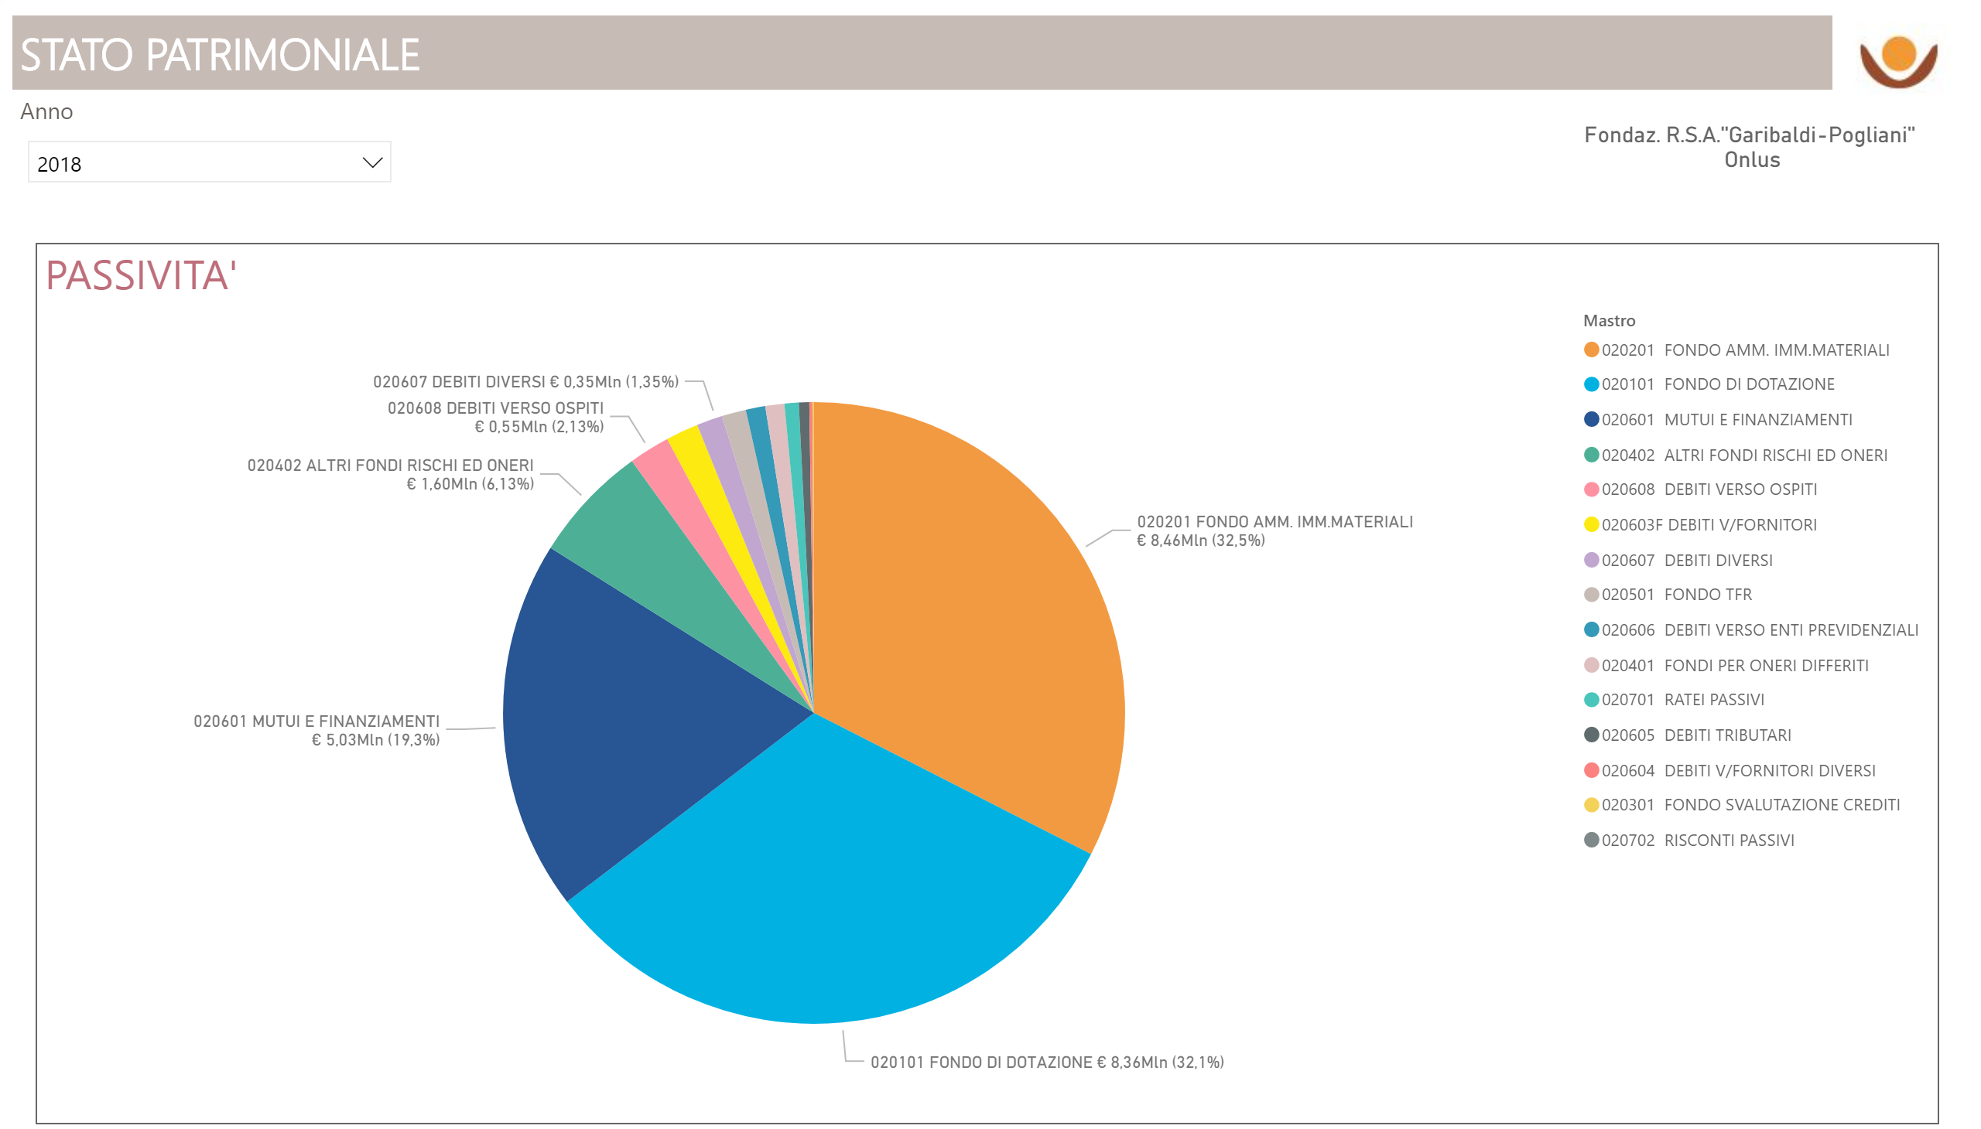

Slide 5
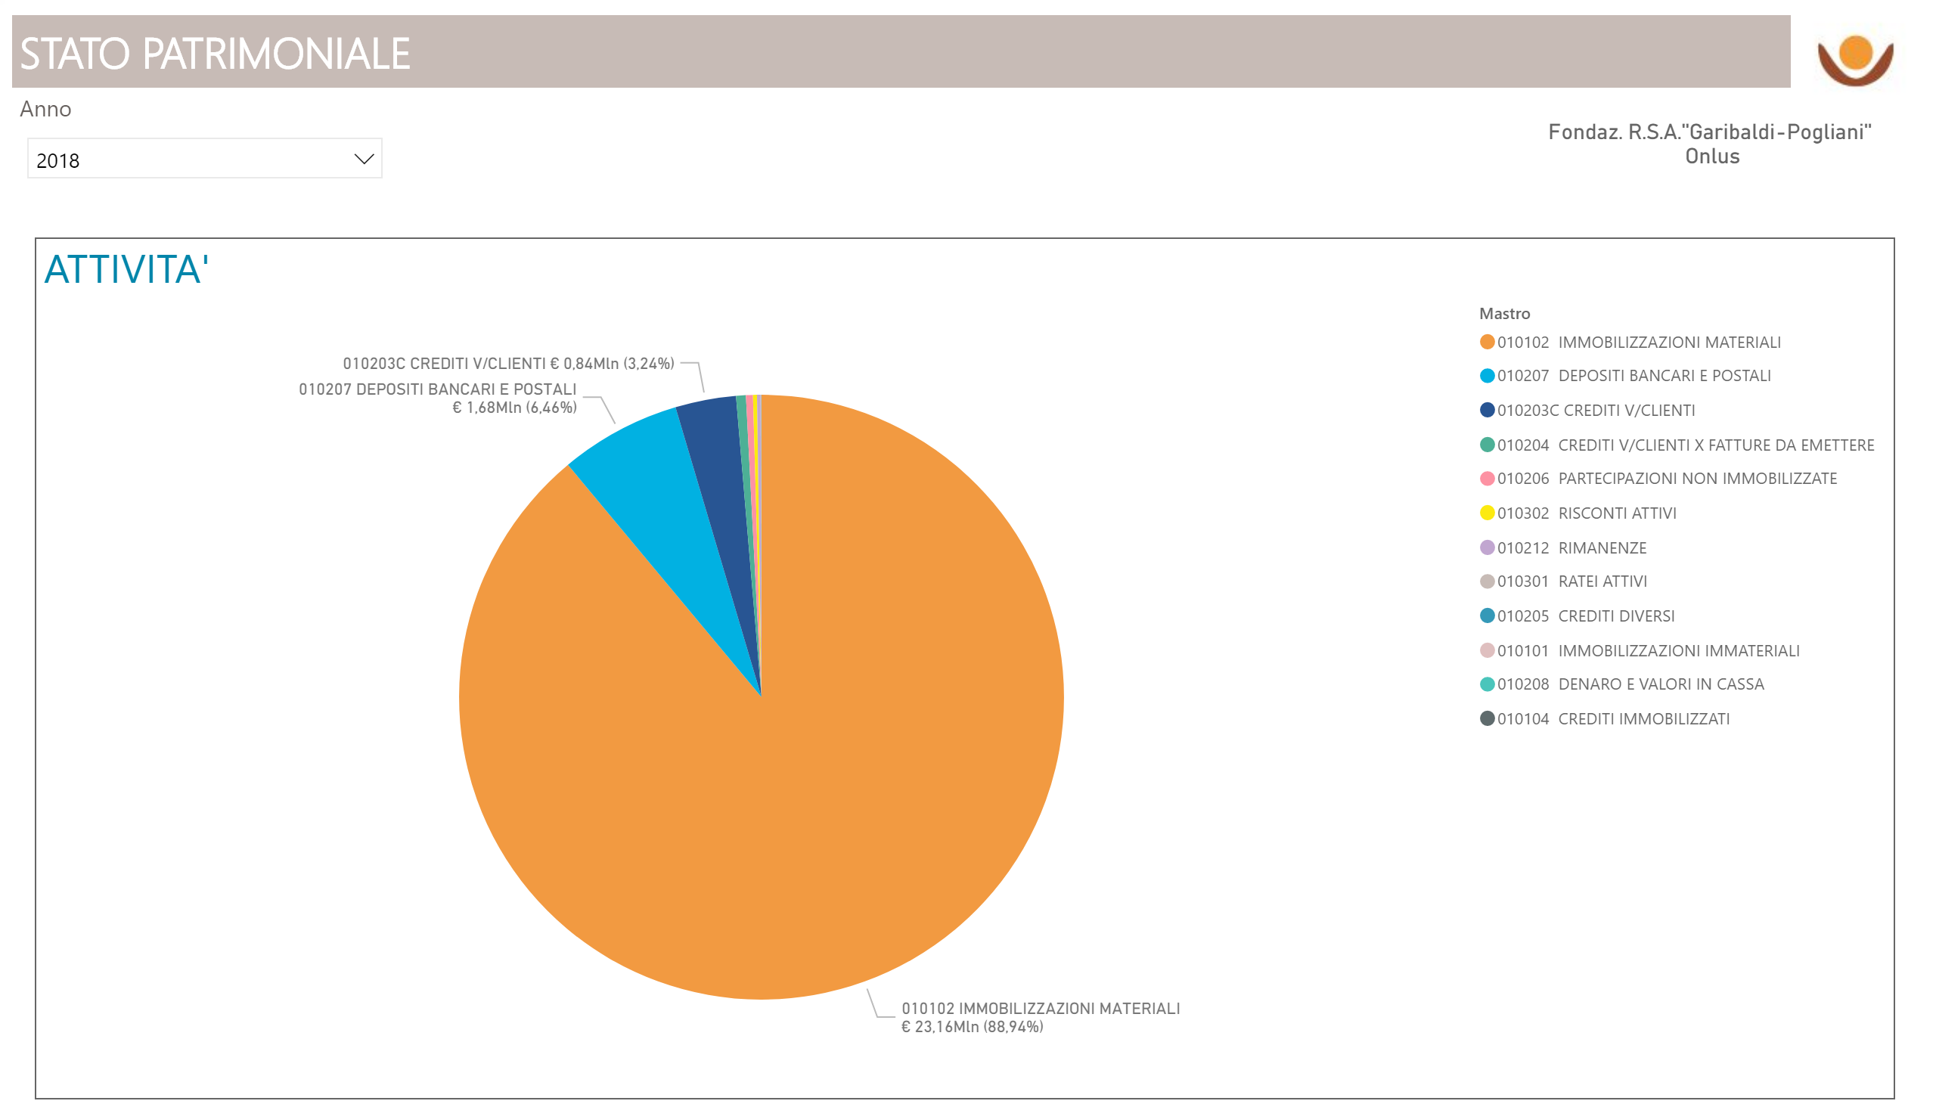

Slide 13
